Slide 1
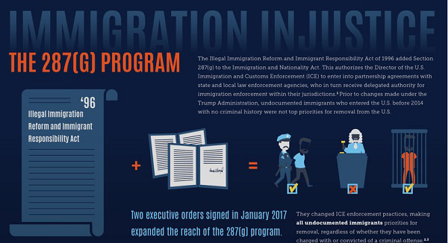
Local Deportation Force
ICE needs the cooperation of local law enforcement.
Local Enforcement
Detention Beds
287(g): Agreements with 59 law enforcement agencies in 17 states. 29 of those agreements were signed in 2017.
ICE plans to continue this higher rate of expansion in 2018.
Data Sharing and Access to Jails
Notes:
500,000 million Deportations

Slide 2
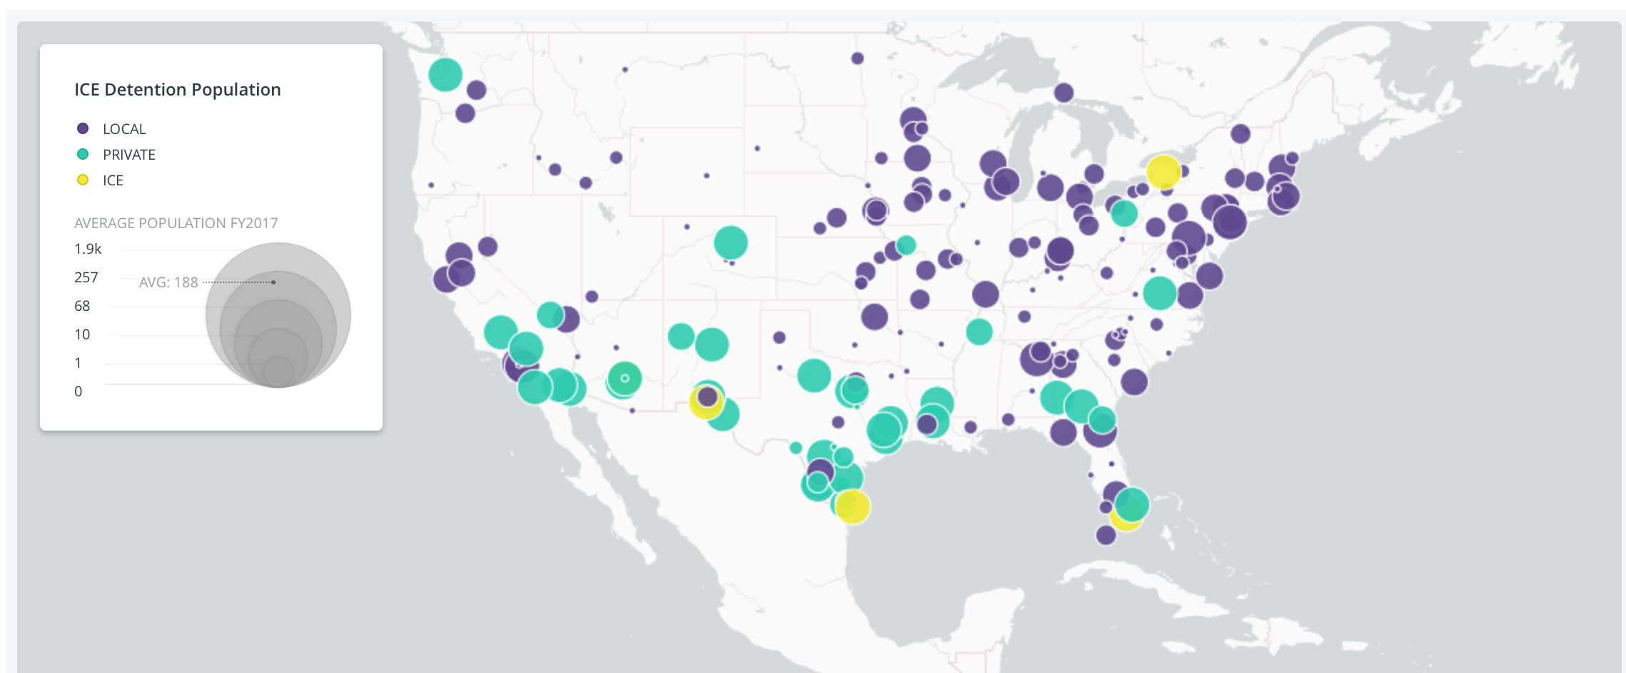
What do you see?
ICE is exploring 4 new detention centers — in Detroit, Chicago, St. Paul, Salt Lake City = 3000-5000 beds
New detention center under Trump - a $110 million, 1,000-bed facility in the Houston-area, operated by the GEO Group - will be open by end of 2018.

Slide 3
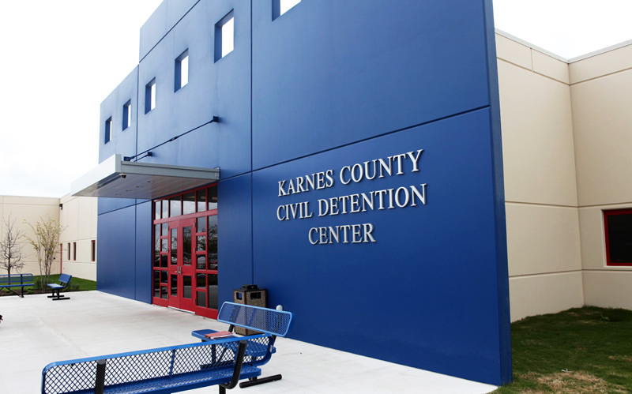
Local Profiting on Detention
In Stewart County, Georgia, an ICE agreement provides revenue that makes up 20 percent of the county’s annual budget.
ICE detention center in Folkston, Georgia, boost its revenue $21 million.
In Conroe, Texas, a facility is expected to bring in $44 million annually from an ICE contract.

Slide 4
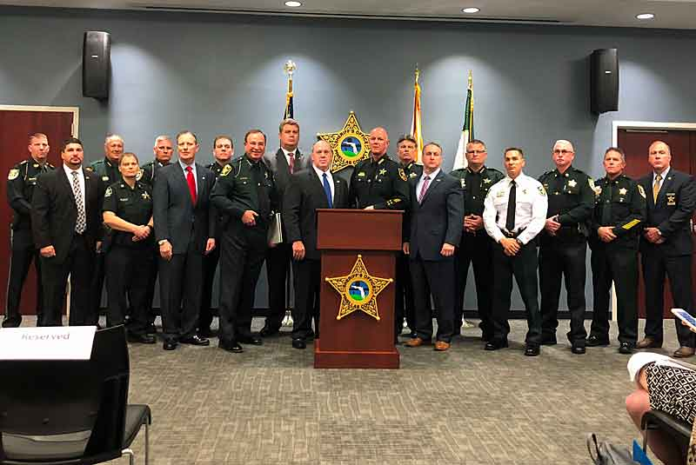
What is a Basic Ordering Agreement (BOA)?
Florida Jan. 2018 - 17 sheriffs announce BOA program
Sheriff holds people for 48 hours after their scheduled release for ICE
In return, ICE pays the sheriff’s office $50 per detainee
A pilot program: A new effort to gain local cooperation
Under a BOA, local jails agree to:
Allow ICE to keep track of detainees as they are booked into and out of rented local jail space;
Keep detainer information secret;
Give ICE free access to their jails to interrogate inmates.
Notes:
Jurisdictions that signed a BOA will allow ICE to keep track of ICE detainees as they are booked into and out of rented local jail space.
Under a BOA, local jails also agree to keep detainer information secret, and to give ICE free access to their jails to interrogate inmates

Slide 5
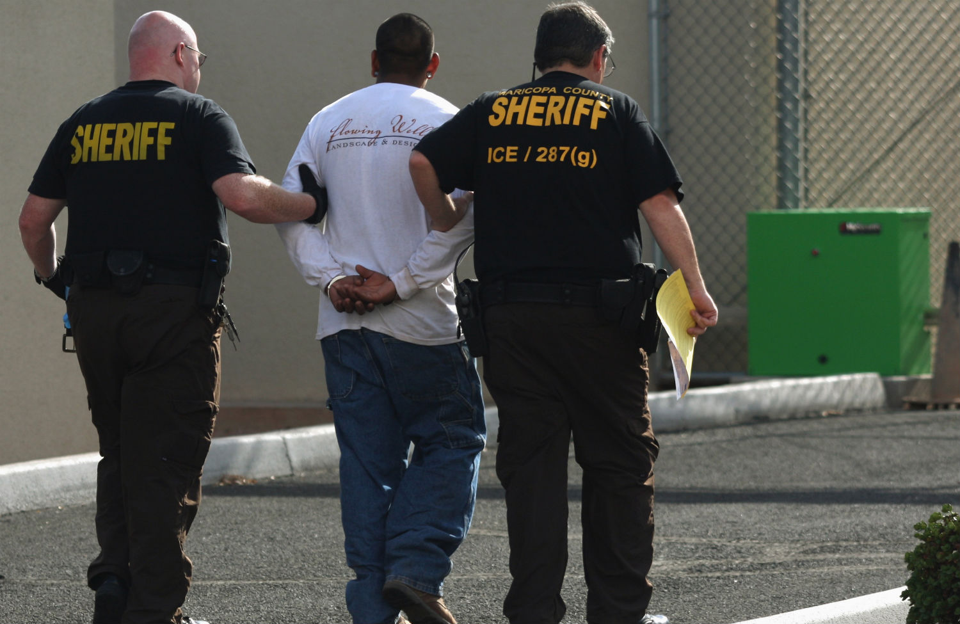
What is new or different about the BOA program?
There are two main changes: (1) new paperwork, and (2) payments to counties for holding people
BOAs do not change the 4th Amendment requirement of probable cause.
BOAs do not protect counties for 4th Amendment violations
BOA - not an enforceable contract: Does not require counties to honor all ICE detainers.
Payments: $50/detainer.
ICE and Counties believe new paperwork & payments effectively transfer detainees to ICE custody while they remain physically in the county jail.

Slide 6
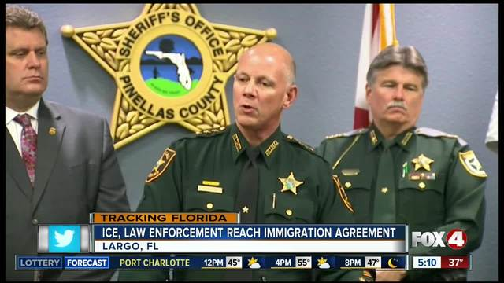
What are the implications?
ICE’s detainer system has been under attack through the courts and through grassroots organizing
Holding people on detainers found unconstitutional in multiple court rulings
DHS, ICE and sheriffs view BOA as a "solution" to unconstitutionality of detainers
If pilot program is “successful” in Florida, BOAs will spread nationwide

Slide 7
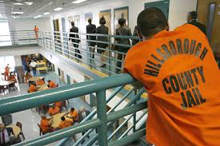
Efforts In Florida to End BOAs
Hillsborough County
Connecting DA work and sheriff work
Sheriff up for election Nov. 2018
Organizing clergy and community leaders to meet with sheriff
Educating and organizing other electeds to put pressure on sheriff
Statewide
Records requests and FOIAs
Looking for cases to start resistance in the courts

Slide 8
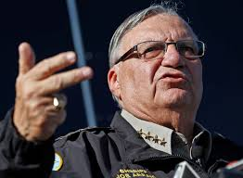
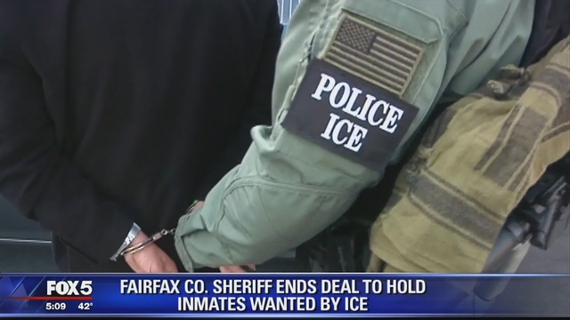
The Power of Sheriffs
Sheriffs are elected officials
Law enforcement and jail authority county-wide
Manage county or regional jails
Most have the power to make arrests and detain people throughout the county
Jails are entry point for detention and deportation
In most cases, sheriffs have sole decision-making authority over how and whether to work with federal authorities
Notes:
Sheriff have an enormous scope of authority + contact with large number of undocumented immigrants = sheriffs’ jails are often the

Slide 9
What makes a pro-immigrant sheriff?
Respects immigrant communities and recognizes that trust between their department and immigrant communities is a key component to public safety.
Publicly declares, and has a written, supporting policy, that their deputies and department will not inquire about immigration status.
Publicly states their job is not to enforce immigration law and demonstrates this commitment by refusing to cooperate with ICE or Border Patrol.
Notes:
Demonstrates respect for immigrant communities by hiring deputies and staff that speak the language(s) of immigrant communities in their jurisdiction.
Works with local immigration attorneys and the state or district attorney’s office to speedily process U-Visa certifications
Collaborates and consults with local immigrant rights groups on how to best conduct community outreach in immigrant communities and provides materials written in language(s) of local immigrant communities.
Deputies and staff are trained on the immigration effects of arrests- such as what bars immigrants from adjusting their status.
Ensures that their entire department is trained on this policy,
The policy outlines clear consequences for deputies and staff that violate the policy.
They support policies or passes policies in their department that:
Refuse to honor ICE detainers,
Do not participate in the 287(g) program,
Reject BOA agreements with ICE,
Do not lease space to ICE or US Marshals for immigration purposes,
Does not give ICE access to information of individuals held locally and/or to local databases

Slide 10
Action Steps
Research Meetings ASAP
If you suspect cooperation: Conduct a public records request
Educate your community and congregations on ICE tactic to gain local cooperation and ask to join the fight
Demand local officials publicly oppose local cooperation with ICE
Hold local officials cooperating or planning to cooperate accountable
Demand for policy changes locally to assure no cooperation

Slide 11
Questions?

Slide 12
Basic Ordering Agreements and the Power of Sheriffs

Slide 13
Agenda
1. Intros and Agenda Review
2. Local Deportation Force
3. What are Basic Ordering Agreements?
What are we seeing?
What are the components/terms of a BOA?
What's new/different?
DHS/ICE + sheriffs view as a "solution" to unconstitutionality of detainers
What are the implications?
DHS/ICE + sheriffs are testing in FL to then roll out across the country.
3. Florida organizing efforts: What is the resistance to BOAs in Florida?
4. Sheriffs: What makes a Pro-Immigrant Sheriff?
5. Action Steps

