Slide 1
“Pledge-In” Before City Council Vote

Slide 2
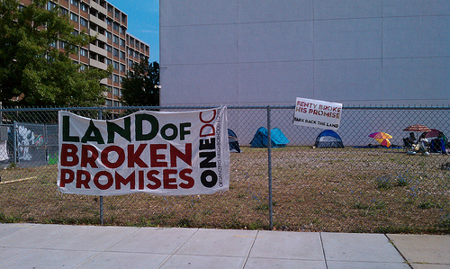
Tent City (Shaw, DC)

Slide 3
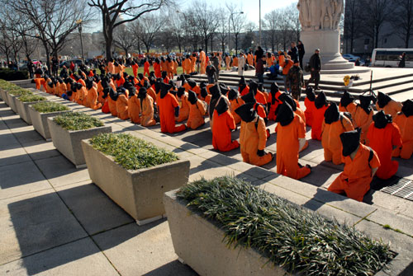
Supreme Court Guantánamo Dramatization

Slide 4
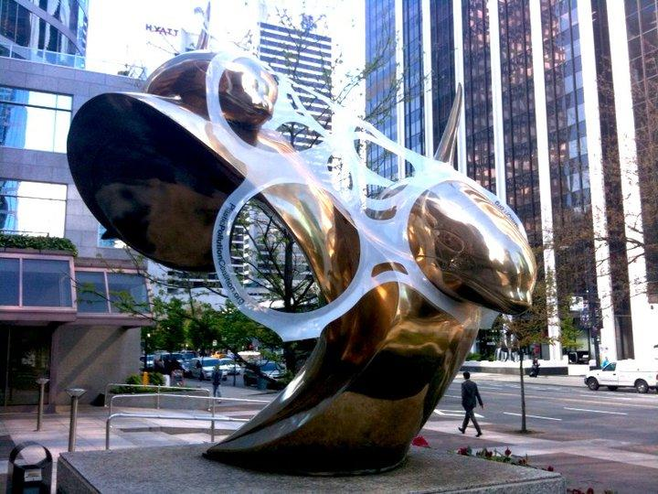

Slide 5
“Dreamers” in the US Capitol

Slide 6
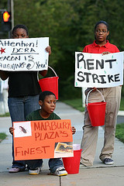
Rent Strike led by children tenants (Anacostia, DC)

Slide 7
“Sing-in sit-in” (Mt. Pleasant, DC)

Slide 8
Occupying Obama’s campaign offices (May 2012)

Slide 9
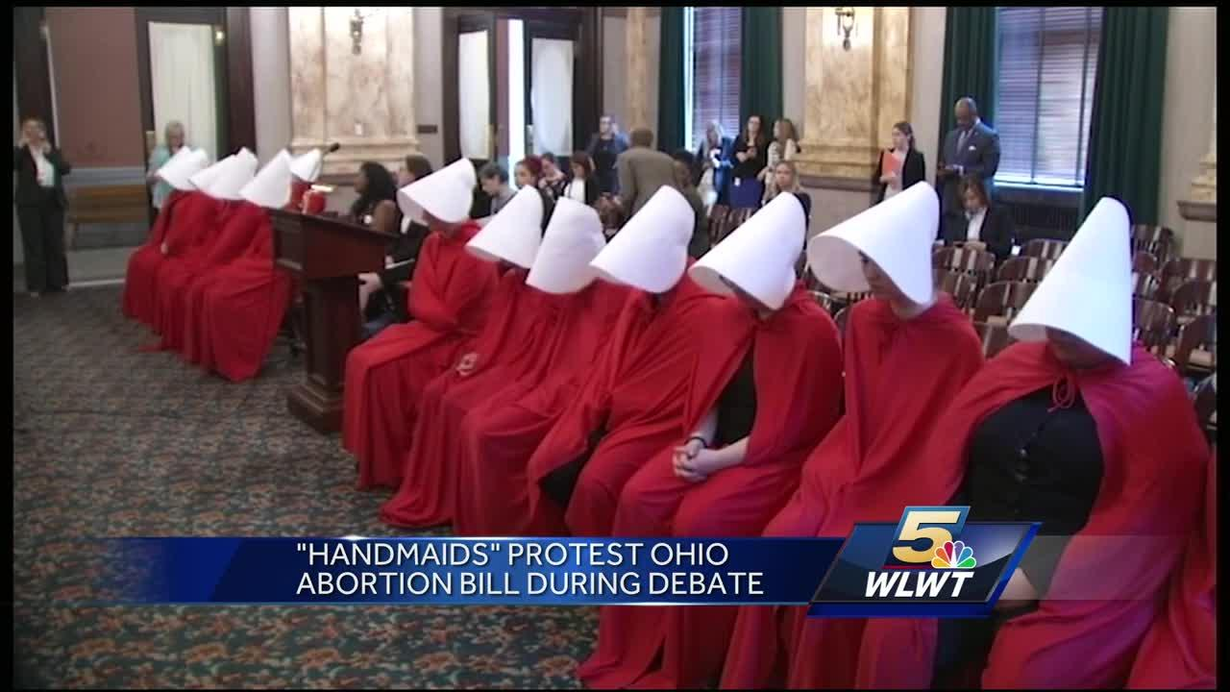
Referencing Pop Culture
to Explain Your Issue

Slide 10
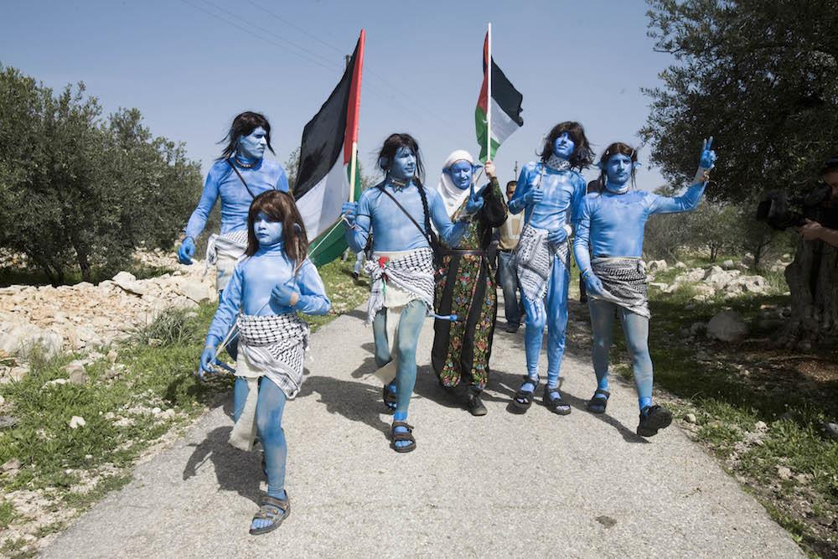
Palestinians demonstrate dressed as “Avatar” characters

Slide 11
“Formation” Protest of Police Brutality

Slide 12
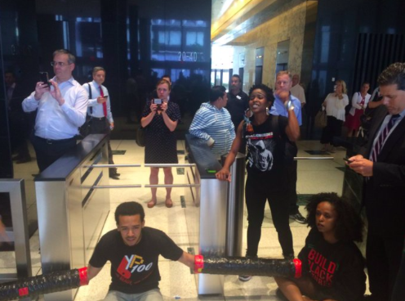
Occupying Police Union Office – to “Shine a Light” on Them for Our People

Slide 13
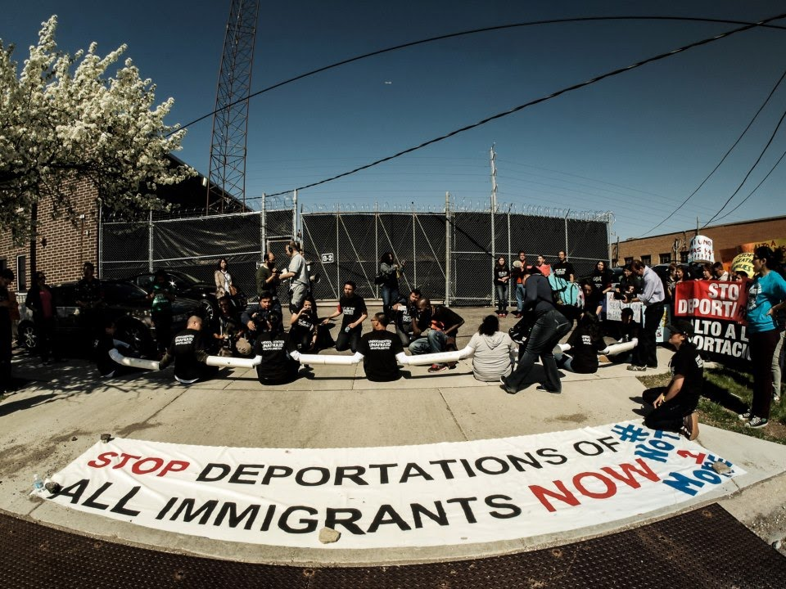
Blocking ICE detention center buses

Slide 14
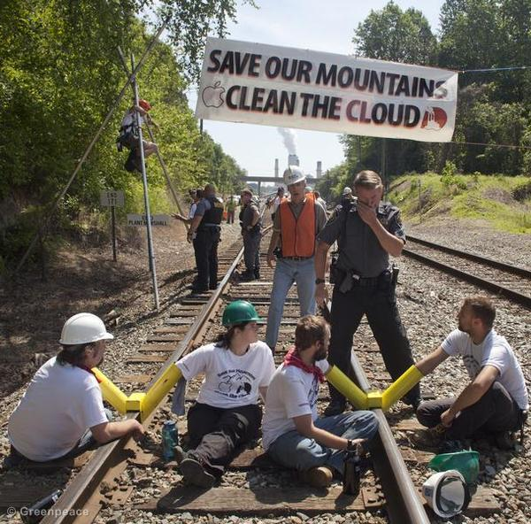

Slide 15
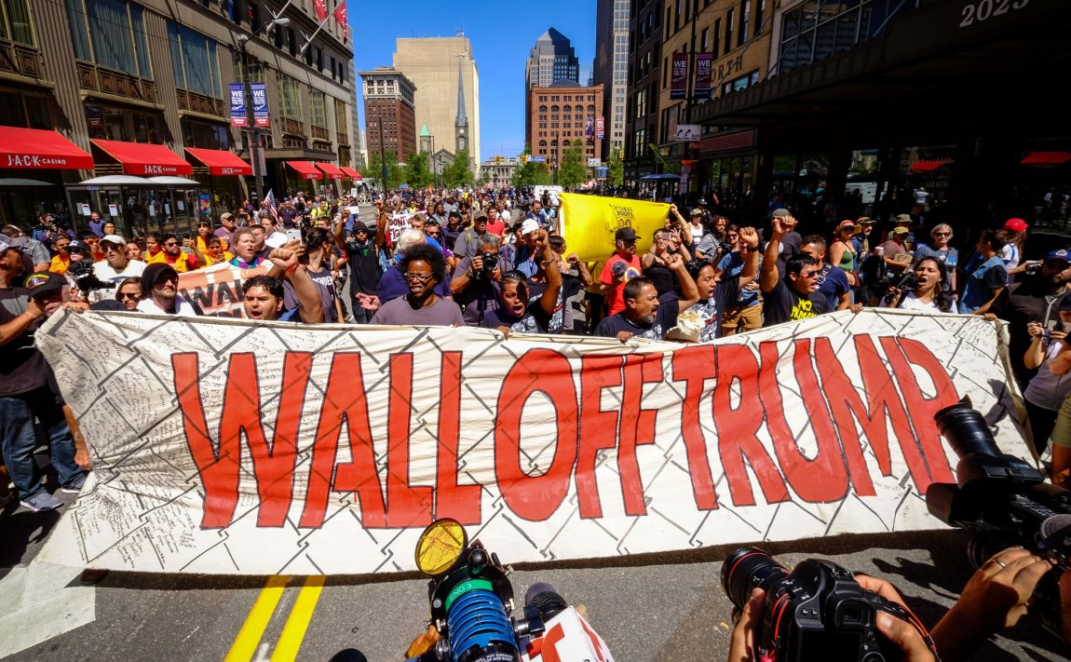

Slide 16
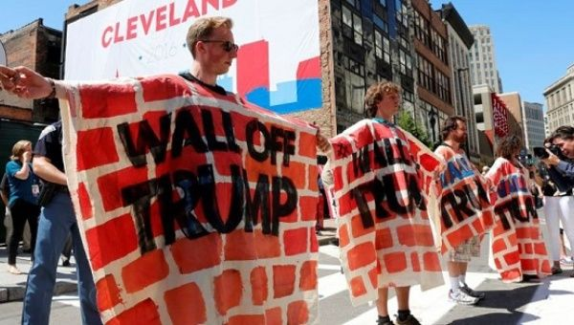
Mijente at RNC – August 2017

Slide 17
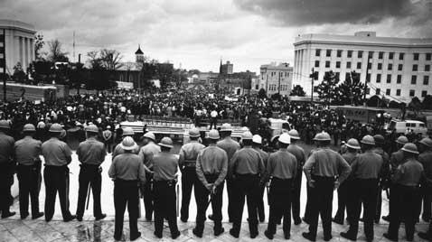
Promising to Cross the Bridge in Selma… Breaking Segregation Laws

Slide 18
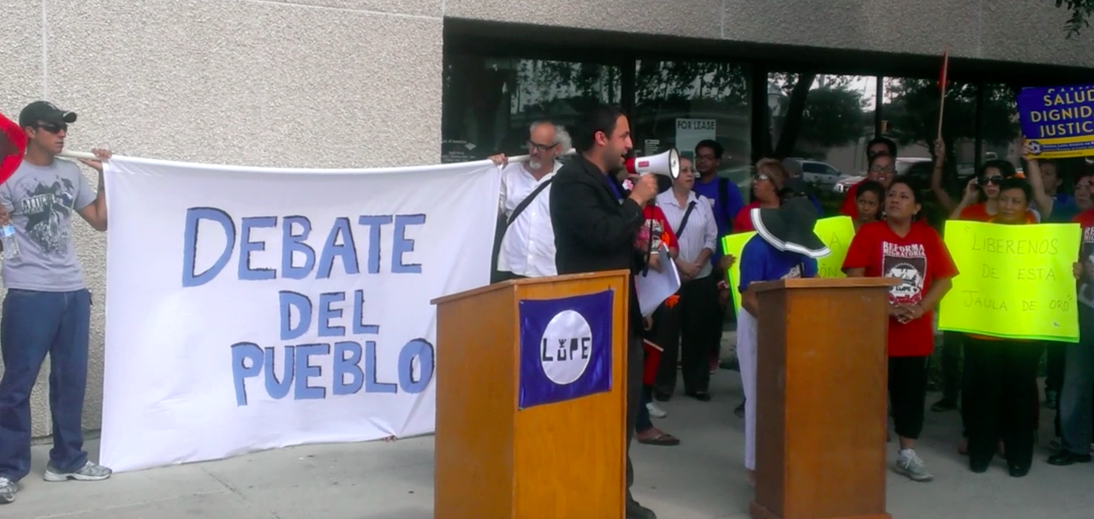
Hold a Public Debate

Slide 19
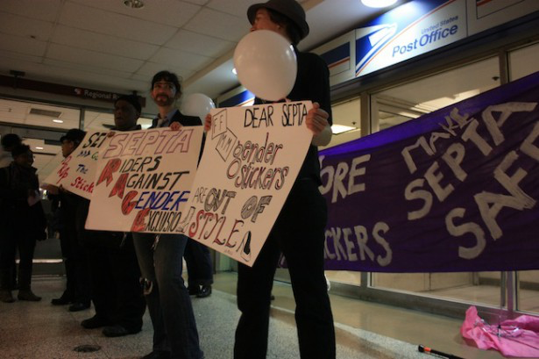
Public Drag Show: “What’s In Your Pants? SEPTA Wants to Know”

Slide 20
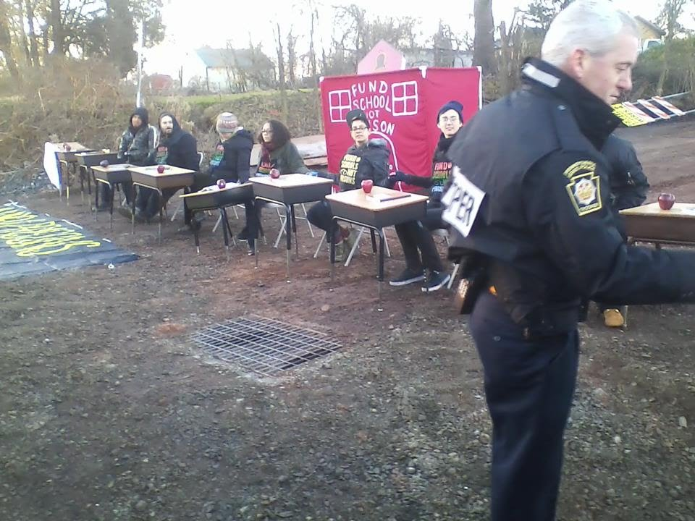
Occupying a prison construction site building a “classroom” (PA, 2013)

Slide 21
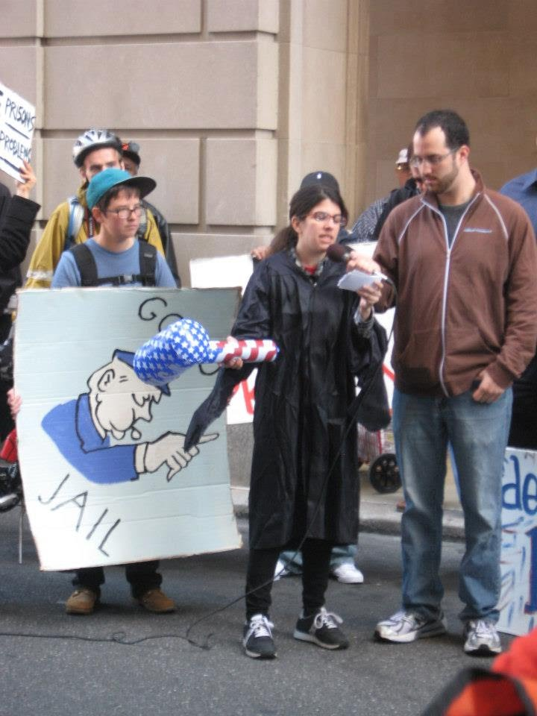
Putting the Governor “on trial” (PA)

Slide 22
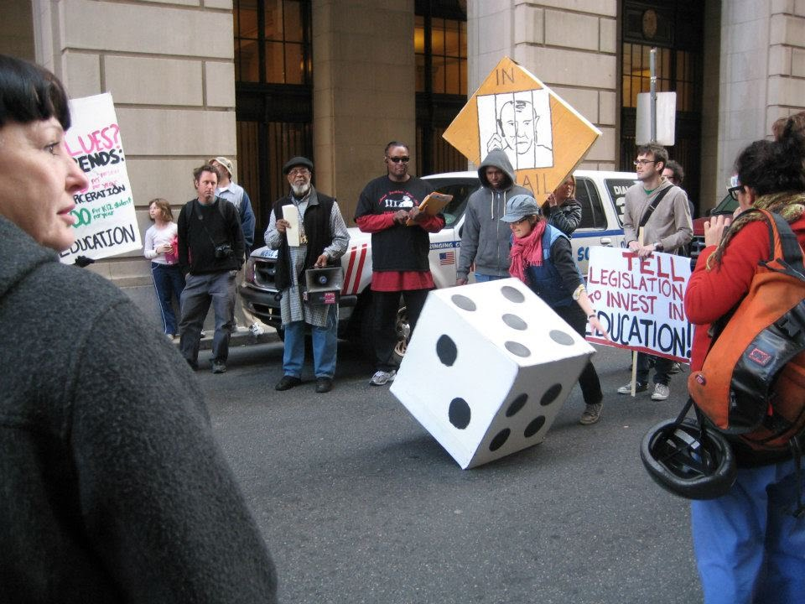
Protest against legislators “rolling the dice” with the lives of PA families

Slide 23
Creative Misunderstanding: “White Power” to “Wife Power” or “White Flour”, or “Dwight Power”

Slide 24
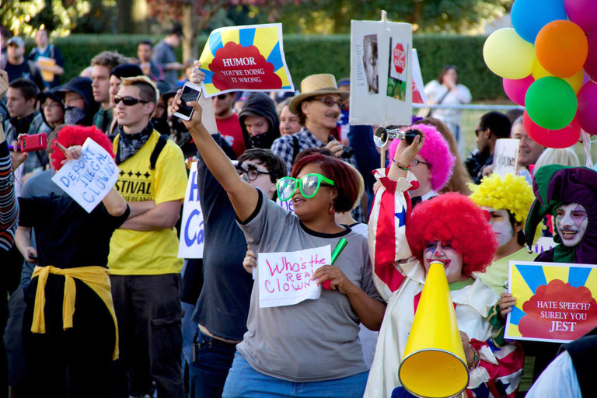
“Who’s the Real Clown?”, “I thought this was a clown convention…”

Slide 25
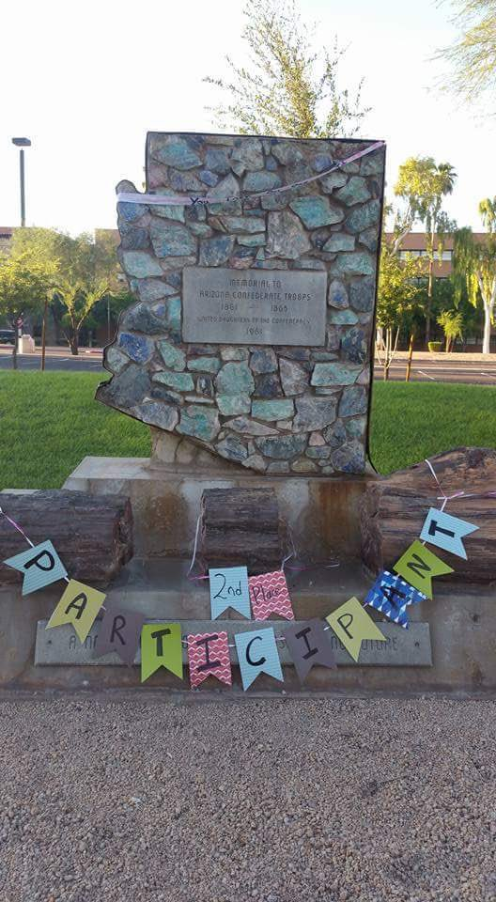
Awarding “2nd place” to a Confederate memorial

Slide 26
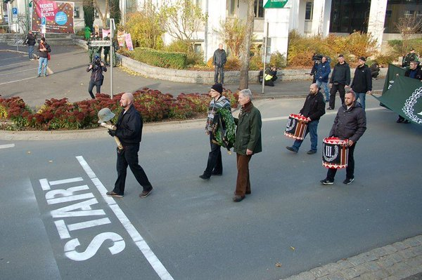
“Involuntary Walkathon” in Germany

Slide 27
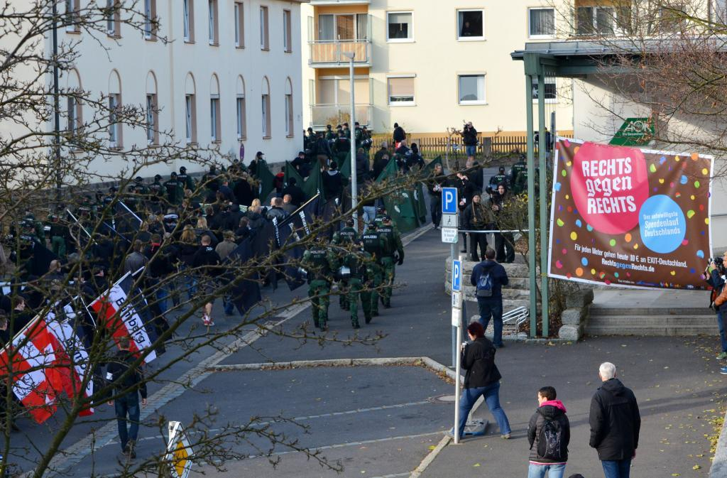

Slide 28
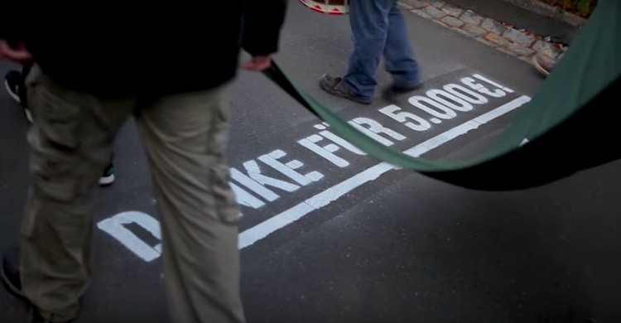

Slide 29
